Slide 1

Lecture
Scheduling

Slide 2

Scheduling
Objective of Scheduling is to achieve trade offs among conflicting goals ,which includes efficient utilization of staff equipment and facilities and minimization of customer waiting time , inventories and processing time.
© 2006 Prentice Hall, Inc.

Slide 3










Importance of Scheduling
Effective and efficient scheduling can be a competitive advantage
Faster movement of goods through a facility means better use of assets and lower costs
Good schedules result in more reliable deliveries
© 2006 Prentice Hall, Inc.

Slide 4











Sequencing Jobs
Specifies the order in which jobs should be performed at work centers
Priority rules are used to dispatch or sequence jobs
FCFS: First come, first served
SPT: Shortest processing time
EDD: Earliest due date
LPT: Longest processing time

Slide 5










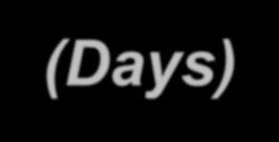









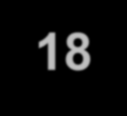




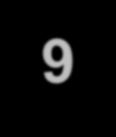

Sequencing Example
Apply the four popular sequencing rules to these five jobs in order to find:
Average Completion time (or average flow time)
Utilization
Iii. Average number of jobs in the system
iv. Average job lateness (or average tardiness)
Job | Job Work (Processing) Time (Days) | Job Due Date (Days)
A | 6 | 8
B | 2 | 6
C | 8 | 18
D | 3 | 15
E | 9 | 23

Slide 6









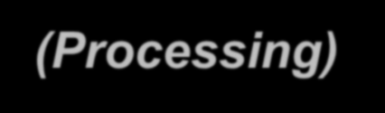










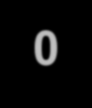







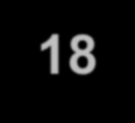
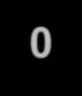


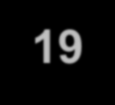



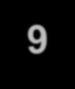
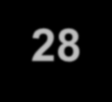
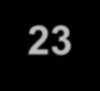




Sequencing Example
FCFS: Sequence A-B-C-D-E
Job Sequence | Job Work (Processing) Time | Flow Time | Job Due Date | Job Lateness
A | 6 | 6 | 8 | 0
B | 2 | 8 | 6 | 2
C | 8 | 16 | 18 | 0
D | 3 | 19 | 15 | 4
E | 9 | 28 | 23 | 5
 | 28 | 77 |  | 11

Slide 7
Sequencing Example
FCFS: Sequence A-B-C-D-E
Job Work
Job (Processing) Flow Job Due Job Sequence Time Time Date Lateness
A 6 6 8 0
B 2 8 6 2
C 8 16 18 0
D 3 19 15 4
E 9 28 23 5
28 77 11
Average completion time = ^{Sum of total flow time} = 77/5 = 15.4 days
Number of jobs
Total job work time
Utilization = _{Sum of total flow time} = 28/77 = 36.4%
Average number of ₌ Sum of total flow time _{= 77/28 = 2.75 jobs}
jobs in the system
Total job work time
Total late days Number of jobs
Average job lateness =
= 11/5 = 2.2 days

Slide 8






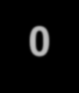








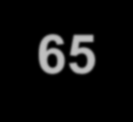
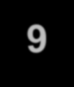
Sequencing Example
SPT: Sequence B-D-A-C-E
Job Sequence | Job Work (Processing) Time | Flow Time | Job Due Date | Job Lateness
B | 2 | 2 | 6 | 0
D | 3 | 5 | 15 | 0
A | 6 | 11 | 8 | 3
C | 8 | 19 | 18 | 1
E | 9 | 28 | 23 | 5
 | 28 | 65 |  | 9

Slide 9
Sequencing Example
SPT: Sequence B-D-A-C-E
Job Work
Job (Processing) Flow Job Due Job Sequence Time Time Date Lateness
B 2 2 6 0
D 3 5 15 0
A 6 11 8 3
C 8 19 18 1
E 9 28 23 5
28 65 9
Average completion time = ^{Sum of total flow time} = 65/5 = 13 days
Number of jobs
Total job work time
Utilization = _{Sum of total flow time} = 28/65 = 43.1%
Average number of ₌ Sum of total flow time _{= 65/28 = 2.32 jobs}
jobs in the system
Total job work time
Total late days Number of jobs
Average job lateness =
= 9/5 = 1.8 days

Slide 10






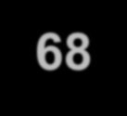

Sequencing Example
EDD: Sequence B-A-D-C-E
Job Sequence | Job Work (Processing) Time | Flow Time | Job Due Date | Job Lateness
B | 2 | 2 | 6 | 0
A | 6 | 8 | 8 | 0
D | 3 | 11 | 15 | 0
C | 8 | 19 | 18 | 1
E | 9 | 28 | 23 | 5
 | 28 | 68 |  | 6

Slide 11
Sequencing Example
EDD: Sequence B-A-D-C-E
Job Work
Job (Processing) Flow Job Due Job Sequence Time Time Date Lateness
B 2 2 6 0
A 6 8 8 0
D 3 11 15 0
C 8 19 18 1
E 9 28 23 5
28 68 6
Average completion time = ^{Sum of total flow time} = 68/5 = 13.6 days
Number of jobs
Total job work time
Utilization = _{Sum of total flow time} = 28/68 = 41.2%
Average number of ₌ Sum of total flow time _{= 68/28 = 2.43 jobs}
jobs in the system
Total job work time
Total late days Number of jobs
Average job lateness =
= 6/5 = 1.2 days

Slide 12


















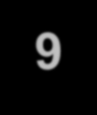
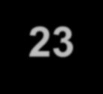
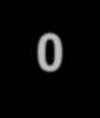


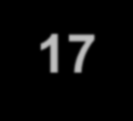

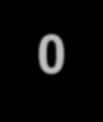


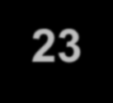













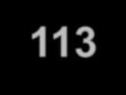
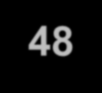
Sequencing Example
LPT: Sequence E-C-A-D-B
Job Sequence | Job Work (Processing) Time | Flow Time | Job Due Date | Job Lateness
E | 9 | 9 | 23 | 0
C | 8 | 17 | 18 | 0
A | 6 | 23 | 8 | 15
D | 3 | 26 | 15 | 11
B | 2 | 28 | 6 | 22
 | 28 | 113 |  | 48

Slide 13



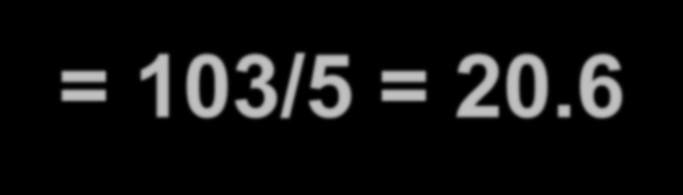




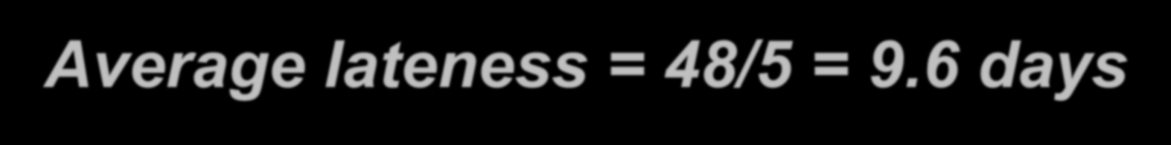
Sequencing Example
LPT: Sequence E-C-A-D-B
Average completion time =
= 103/5 = 20.6 days
Utilization = 28/103 = 27.2%
Average number of jobs in the system = 103/28 = 3.68 jobs
Average lateness = 48/5 = 9.6 days

Slide 14








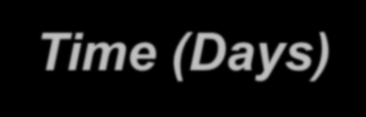
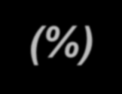
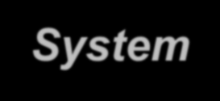
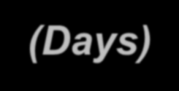

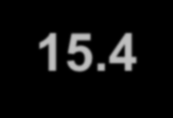
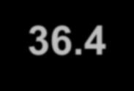
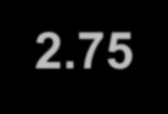
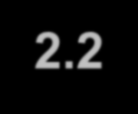

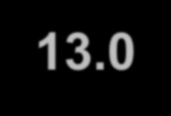
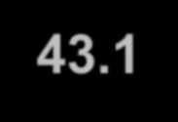
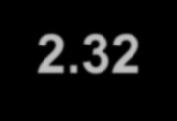
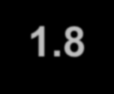

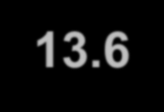
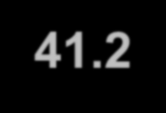
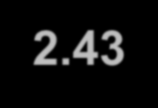
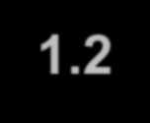

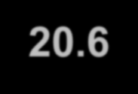
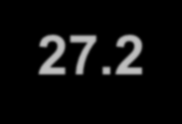
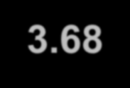
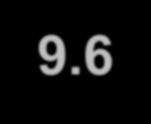
Sequencing Example
Summary of Rules
Rule | Average Completion Time (Days) | Utilization (%) | Average Number of Jobs in System | Average Lateness (Days)
FCFS | 15.4 | 36.4 | 2.75 | 2.2
SPT | 13.0 | 43.1 | 2.32 | 1.8
EDD | 13.6 | 41.2 | 2.43 | 1.2
LPT | 20.6 | 27.2 | 3.68 | 9.6

Slide 15






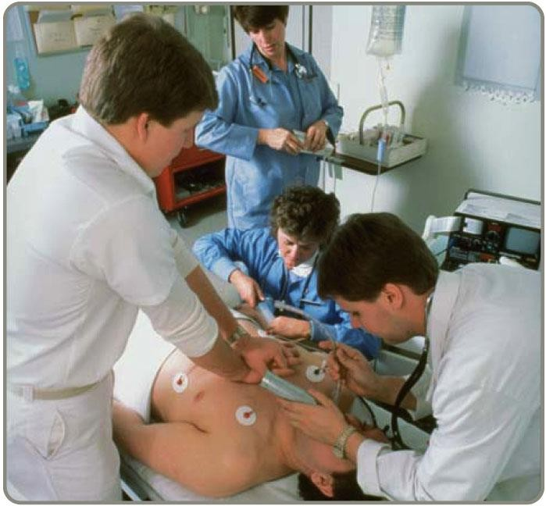







Comparison of Sequencing Rules
No one sequencing rule excels on all criteria
SPT does well on minimizing flow time and number of jobs in the system
But SPT moves long jobs to the end which may result
in dissatisfied customers
FCFS does not do especially well (or poorly) on any criteria but is perceived
as fair by customers
EDD minimizes lateness

Slide 16


















Critical Ratio (CR)
Critical ratio is an index number found by dividing the time remaining until the due date by the work time remaining on the job
Jobs with low critical ratios are scheduled ahead of jobs with higher critical ratios
Performs well on average job lateness criteria
Time remaining
Due date -Today’s date
CR =
=
Processing time
Processing time

Slide 17

Critical Ratio Example
Job | Job Work Time | Due Date | CR
A | 6 | 8 | (8-0)/6 =1.33(lowest)
B | 2 | 6 | (6-0)/2=3
C | 8 | 18 | (18-0)/8=2.25
D | 3 | 15 | (15-0)/3=5
E | 9 | 23 | (23-0)/9 = 2.56
So, at day 6 , A is completed. The new Critical Ratios are:

Slide 18

Critical Ratio Example
Job | Job Work Time | Due Date | CR
B | 2 | 6 | (6-6)/2=0 (lowest)
C | 8 | 18 | (18-6)/8=1.5
D | 3 | 15 | (15-6)/3=3
E | 9 | 23 | (23-6)/9=1.89
So, at day 8, B is completed. New Critical Ratios
are:

Slide 19
Critical Ratio Example
Job | Job Work Time | Due Date | CR
C | 8 | 18 | (18-8)/8=1.25 (lowest)
D | 3 | 15 | (15-8)/3=2.33
E | 9 | 23 | (23-8)/9=1.67
So, at day 16, C is completed. New Critical Ratios are:
Job | Job Work Time | Due Date | CR
D | 3 | 15 | (15-16)/3 = -0.33 (lowest)
E | 9 | 23 | (23-16)/9= 0.78

Slide 20




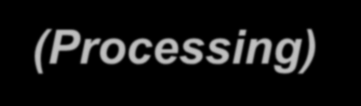










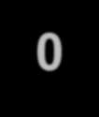








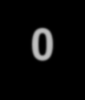






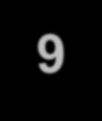






Critical Ratio Example
So the sequence is A-B-C-D-E
Job Sequence | Job Work (Processing) Time | Flow Time | Job Due Date | Job Lateness
A | 6 | 6 | 8 | 0
B | 2 | 8 | 6 | 2
C | 8 | 16 | 18 | 0
D | 3 | 19 | 15 | 4
E | 9 | 28 | 23 | 5
 | 28 | 77 |  | 11

Slide 21
Critical Ratio Example
Average completion time = 77/5 = 15.4 days Utilization = 28/77 = 36.4%
Average number of jobs in the system = 77/28 = 2.75
jobs
Average lateness = 11/5 = 2.2 days

Slide 22








Sequencing N Jobs on Two Machines: Johnson’s Rule
Works with two or more jobs that pass through the same two machines or work centers
Minimizes total production time and idle time

Slide 23















Johnson’s Rule
List all jobs and times for each work center
Choose the job with the shortest activity time. If that time is in the first work center, schedule the job first. If it is in the second work center, schedule the job last.
Once a job is scheduled, it is eliminated from the list
Repeat steps 2 and 3 working toward the center of the sequence

Slide 24



Johnson’s Rule Example
Job | Work Center 1 (Drill Press) | Work Center 2 (Lathe)
A | 5 | 2
B | 3 | 6
C | 8 | 4
D | 10 | 7
E | 7 | 12

Slide 25
Johnson’s Rule Example
Job | Work Center 1 (Drill Press) | Work Center 2 (Lathe)
A | 5 | 2
B | 3 | 6
C | 8 | 4
D | 10 | 7
E | 7 | 12
A
Job | Work Center 1 (Drill Press) | Work Center 2 (Lathe)
A | 5 | 2
B | 3 | 6
C | 8 | 4
D | 10 | 7
E | 7 | 12
B
A

Slide 26
Johnson’s Rule Example
Job | Work Center 1 (Drill Press) | Work Center 2 (Lathe)
A | 5 | 2
B | 3 | 6
C | 8 | 4
D | 10 | 7
E | 7 | 12
B
C
A
Job | Work Center 1 (Drill Press) | Work Center 2 (Lathe)
A | 5 | 2
B | 3 | 6
C | 8 | 4
D | 10 | 7
E | 7 | 12
B
E D
C
A

Slide 27
























Johnson’s Rule Example
Job | Work Center 1 (Drill Press) | Work Center 2 (Lathe)
A | 5 | 2
B | 3 | 6
C | 8 | 4
D | 10 | 7
E | 7 | 12
B E D C A

Slide 28








Johnson’s Rule Example
Job | Work Center 1 (Drill Press) | Work Center 2 (Lathe)
A | 5 | 2
B | 3 | 6
C | 8 | 4
D | 10 | 7
E | 7 | 12
B E D C A
Time 0
3
10
20
28 33
35
WC
1
B
E
D
C
A
E
WC 2
B
E
D
C
A

Slide 29



























Johnson’s Rule Example
Job | Work Center 1 (Drill Press) | Work Center 2 (Lathe)
A | 5 | 2
B | 3 | 6
C | 8 | 4
D | 10 | 7
E | 7 | 12
B E D C A
Time 0
3
10
20
28 33
WC
1
B
E
D
C
A
WC 2
B
E
D
C
A
Time➔ 0
1 3 5 7 9 10 11 12 13 17 19 21 22 2325 27 29 31 33 35
B
E
D
C
A

Slide 30

Practice Yourself
JOB | Work center(1) | Work center(2)
A | 7 | 2
B | 9 | 4
C | 3 | 5
D | 1 | 2
E | 5 | 8

Slide 31









Gant Chart
This is also known as “Gant Chart” or time phrase chart.
Note: When you will compare the data always compare it with all the data. If there are 10 processing time of 2 work centers for choosing the sequence u need to consider all the jobs.

Slide 32


